Slide 1


Azure Functions C# Serverless Development from Zero to Hero
Bhushan POOJARY

Slide 2

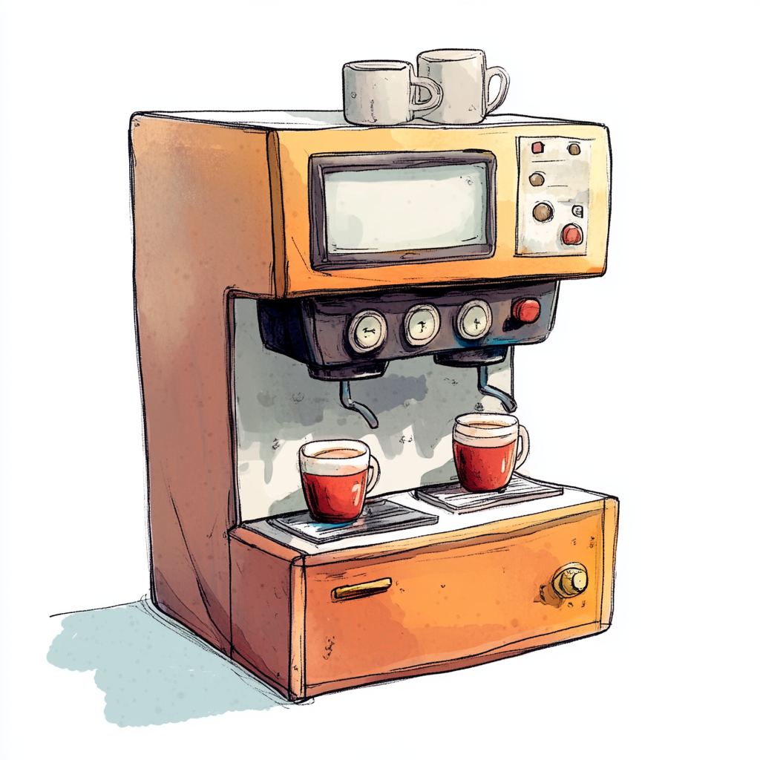
What is Serverless Architecture?
Traditional Architecture: Running a Coffee Shop
Serverless Architecture: Using a Coffee Vending Machine

Slide 3
What is Serverless Architecture?
You rent the shop, hire staff, buy equipment, and keep it running all day.
Even if no customers come in, you're still paying for rent, electricity, and salaries.
You have full control, but also full responsibility.
You place a machine in a public space.
It only works when someone presses a button (an event).
You don’t pay for idle time.
Maintenance, power, and refilling are handled by someone else (the cloud provider).
You just provide the coffee recipe (your code).

Slide 4
Why This Analogy Works:
Concept | Coffee Shop | Vending Machine
Server Management | You manage it all | Provider manages it
Cost | Fixed (rent, staff) | Pay per use
Scaling | Hire more staff | Deploy more machines
Downtime Risk | High if poorly managed | Handled by provider
Deployment Time | Long (setup, licenses) | Instant (just place it)
"With serverless, you're not running the café — you're just giving the recipe and letting the cloud serve coffee whenever someone asks."

Slide 5

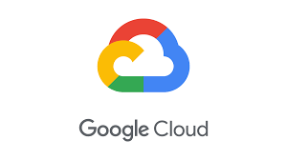

What is Serverless Architecture?
Serverless architecture is a cloud computing model where developers write and deploy code without worrying
about the underlying infrastructure — like servers, provisioning, scaling, or maintenance.
⚠️ “Serverless” doesn't mean there are no servers. It means you don’t have to manage them.
Cloud providers like Azure, AWS, or GCP handle all of that for you.

Slide 6

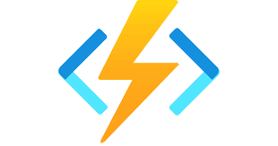
Real-world Use Case
Let’s say you want to process uploaded images:
In a serverless setup, an Azure Function is triggered every time a new image is uploaded to blob storage.
It processes the image, resizes it, and saves it — without you managing any virtual machines.

Slide 7
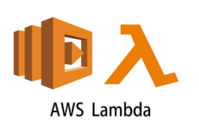
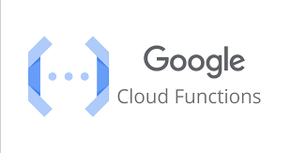
Common Serverless Platforms

Slide 8
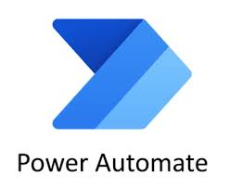
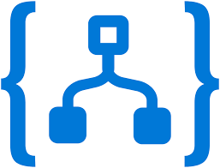
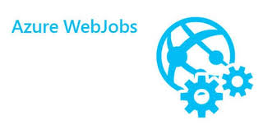
Azure serverless apps
Design First
Code First

Slide 9
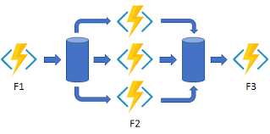
Azure functions and Azure Durable Functions
Azure functions
Azure Durable functions

Slide 10

When to Use Azure Functions
"Using Azure Functions is like calling a handyman only when you need a specific quick task done, instead of hiring a full-time employee."

Slide 11
When to Use Azure Functions
Azure Functions is ideal when you need to run small pieces of code (functions) in the cloud without worrying about infrastructure. Use it in the following scenarios:
🔁 Event-Driven Processing
⚡ Short-Lived, Lightweight Logic
🧵 Microservices Architecture
📉 Infrequent or Unpredictable Workloads
💸 Cost-Optimized for Low Usage

Slide 12
🔁 Event-Driven Processing
Use when your code should respond to events like:
New messages in a queue (e.g., Azure Queue Storage, Service Bus)
Blob storage changes (e.g., file uploads)
HTTP requests (API endpoints)
Timer-based triggers (e.g., scheduled tasks like CRON)
Example: Resize images automatically after they're uploaded to blob storage.

Slide 13
⚡ Short-Lived, Lightweight Logic
Use when you have small, single-purpose logic to execute:
Data cleanup tasks
Email or notification senders
Processing order updates
Simple webhooks

Slide 14
🧵 Microservices Architecture
Use when building modular, loosely-coupled services:
Break monolithic apps into function-level services
Deploy independently, scale automatically

Slide 15
📉 Infrequent or Unpredictable Workloads
Use when:
You don’t want to pay for idle compute
You have bursty or unpredictable workloads (auto-scaling is built-in)

Slide 16
💸 Cost-Optimized for Low Usage
Use when cost is a concern:
You only pay for the time your function runs
Great for startups, small tools, or MVPs

Slide 17

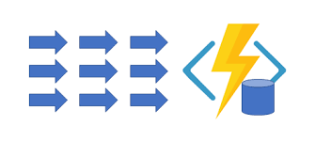
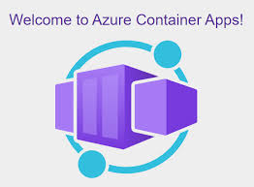
🚫 When Not to Use Azure Functions
For long-running jobs (unless using Durable Functions)
When you need control over infrastructure (e.g., networking, VMs)
For high-performance computing (consider Azure Container Apps or Kubernetes)

Slide 18

Overview of Azure Function Triggers and Bindings
Input Bindings
Triggers
Output Bindings

Slide 19
Triggers (What starts the function)
A trigger is an event that causes your Azure Function to run. Every function must have exactly one trigger.
Trigger Type | Description | Example Use Case
HTTP Trigger | Executes when an HTTP request is received | REST API endpoints
Timer Trigger | Runs on a schedule (CRON) | Scheduled tasks, cleanup jobs
Queue Trigger (Storage Queue) | Fires when a new message is added to a storage queue | Background processing
Service Bus Trigger | Runs when a message is received from a Service Bus queue or topic | Enterprise messaging patterns
Blob Trigger | Starts when a new file is uploaded or modified in Blob Storage | Image processing
Event Hub Trigger | Responds to high-throughput streaming data | IoT telemetry
Event Grid Trigger | Executes on events from Event Grid (e.g., resource changes) | Respond to blob creation
Cosmos DB Trigger | Executes when documents change in Cosmos DB | Real-time processing of database changes

Slide 20
Bindings (Input/Output data connections)
Bindings let you declaratively connect to external resources—like databases, queues, and storage—without writing boilerplate code.
Input Bindings: Bring data into the function
Output Bindings: Send data out of the function
You can have:
Multiple input and output bindings
Bindings configured in function.json or via attributes in C#/.NET

Slide 21
Bindings (Input/Output data connections)
Binding Type | Direction | Use Case
Blob Storage | Input/Output | Read/write files from storage
Table Storage | Input/Output | Read/write structured NoSQL data
Queue Storage | Output | Send a message to a queue
Service Bus | Output | Publish events to a topic or queue
Cosmos DB | Input/Output | Interact with NoSQL document data
SignalR | Output | Push real-time updates to clients
SendGrid | Output | Send emails

Slide 22
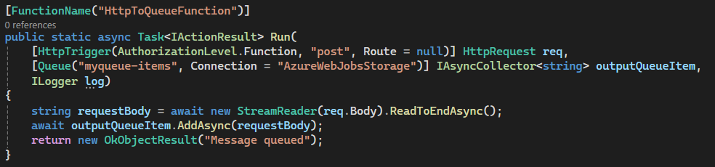
Example in C# (.NET)

Slide 23
In Prcocess and Isolated Durable Function
❌ In-Process: Your function shares the same process and memory space as the Azure Functions runtime.
✅ Isolated: Your function runs in a completely separate process (think of it as a microservice model), communicating with the Azure Functions runtime over gRPC.

Slide 24
Functions Worker
🟢 .NET 8.0 (Long Term Support)
Model: In-Process
Description: The function runs within the same process as the Azure Functions runtime.
Pros:
Easier access to bindings and triggers
Smaller cold start time
Simple debugging
Use case: Most general-purpose apps. Best for beginners.

Slide 25
Functions Worker
🟣 .NET 8.0 Isolated (Long Term Support)
Model: Isolated Process Model
Description: The function runs in its own process, separate from the Azure Functions runtime.
Pros:
Greater control over the app's startup, middleware, and dependencies
Ideal for modern, clean architecture
Future-proof (Microsoft is moving towards isolated model)
Cons: Slightly more complex
Use case: Microservices, complex enterprise apps

Slide 26
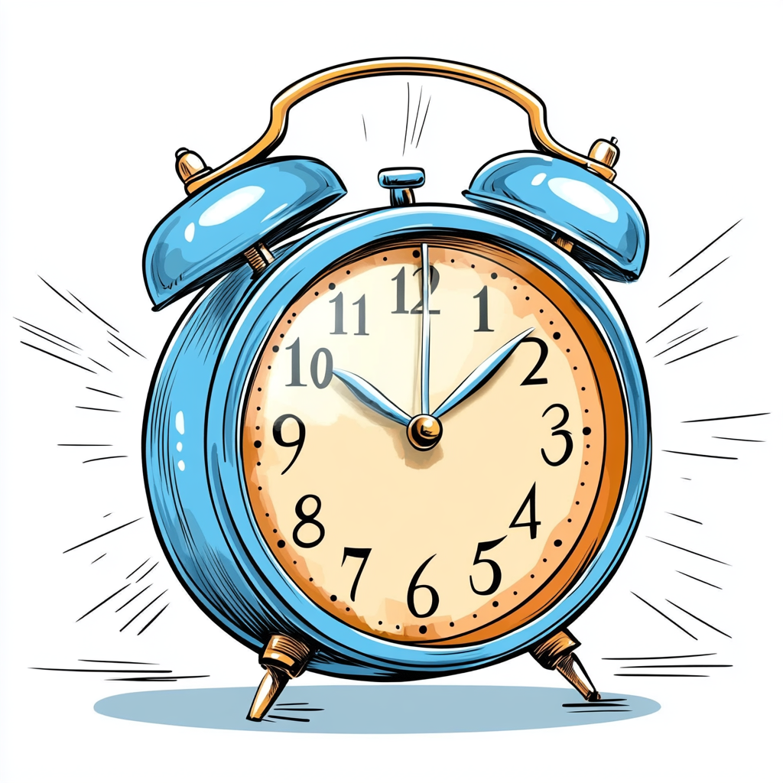
Timer Trigger in Azure Functions
Concept
A Timer Trigger runs your function on a schedule, just like a cron job or alarm clock.
🕒 Think of it like a reminder app: "Run this function every day at 8 AM.“
✅ Use Cases:
Daily report generation
Cleanup tasks
Scheduled database backups

Slide 27
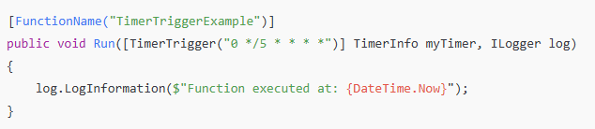
Timer Trigger in Azure Functions
https://crontab.guru/

Slide 28
What is a Queue Trigger?
A Queue trigger is a type of Azure Function that automatically runs when a new message is added to an Azure Storage Queue.
👉 Think of it as "Run this code whenever something gets dropped into the queue."
📦 Use case: Imagine you receive user registrations. You don’t want to send welcome emails immediately — instead, you drop a message into a queue, and a function picks it up and sends the email asynchronously.

Slide 29
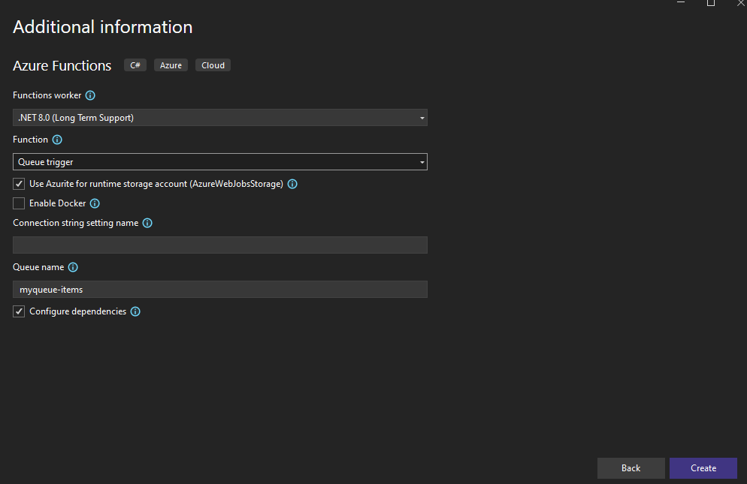
Queue Trigger

Slide 30
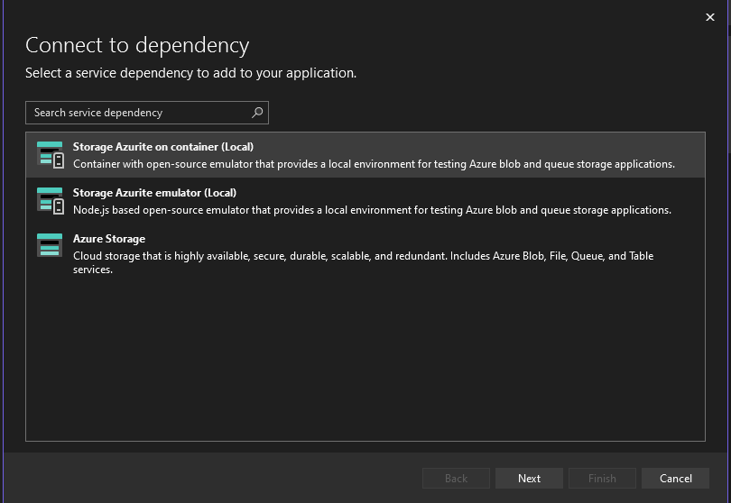
Queue Trigger

Slide 31
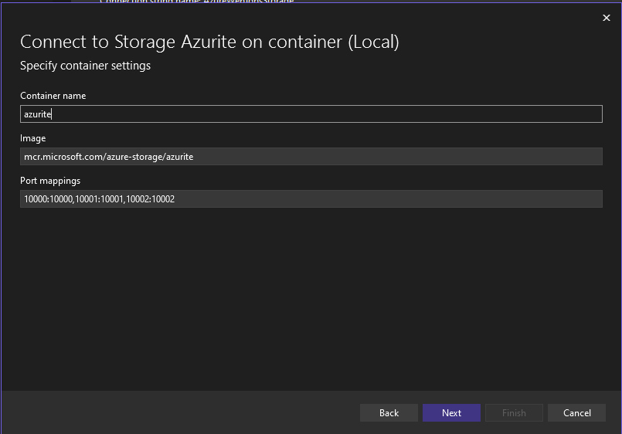
Queue Trigger

Slide 32
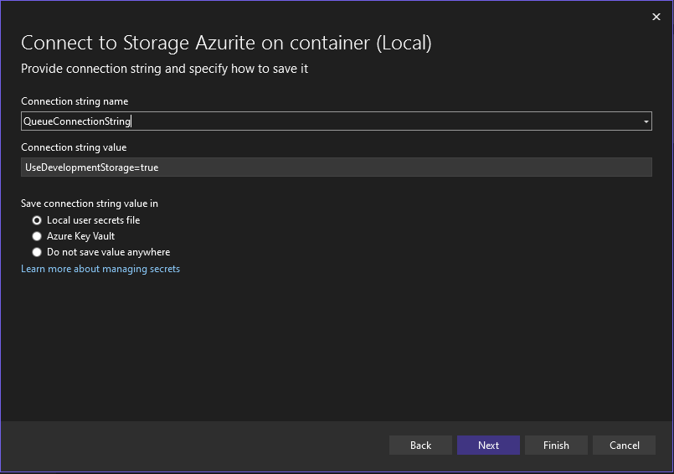
Queue Trigger

Slide 33
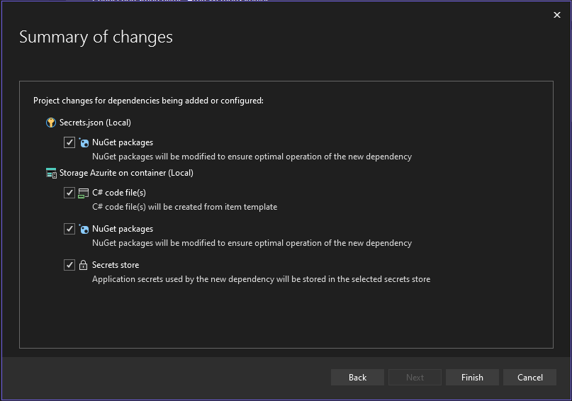
Queue Trigger

Slide 34
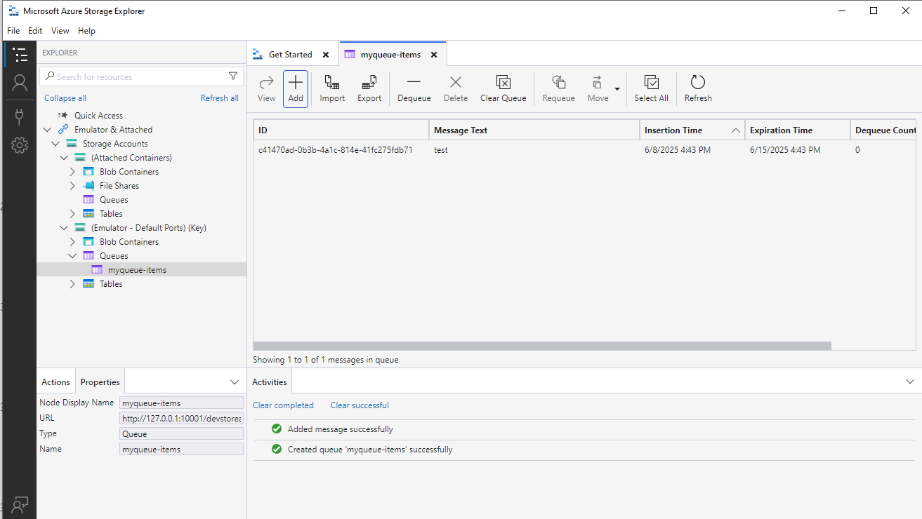
Queue Trigger: Storage Explorer
https://azure.microsoft.com/en-us/products/storage/storage-explorer/#Download-4

Slide 35

Blob Trigger
"A Blob Trigger is a type of Azure Function that automatically runs when a file (called a blob) is added to or modified in an Azure Blob Storage container.“
Real-world Analogy
“Imagine a Dropbox folder shared with your team. Every time someone uploads a file to the folder, an automatic notification is sent to a processing script that scans and categorizes the file. Blob Trigger works the same way—it reacts to file uploads in Azure Blob Storage.”

Slide 36
Blog Trigger: When to Use It
Image processing (e.g., resize or watermark uploaded photos)
Log aggregation
Trigger data pipeline when new data arrives (e.g., CSV, JSON)
OCR on uploaded scanned documents
Backing up or transforming incoming data

Slide 37

Consumption Plan vs Premium Plan vs Dedicated Plan
Imagine You're Hosting a Party
Consumption Plan: You rent a hall only when guests arrive. You don’t pay if nobody shows up.
Premium Plan: You rent a bigger hall that’s always ready, with air-conditioning and faster service—even if no one shows up.
Dedicated Plan (App Service Plan): You buy your own event hall, always available, even if you throw no parties.

Slide 38
Consumption Plan vs Premium Plan vs Dedicated Plan
Feature | Consumption Plan | Premium Plan | Dedicated Plan (App Service)
Billing | Pay-per-execution | Pay for reserved capacity | Pay for always-on infrastructure
Scaling | Auto-scale (0 to many) | Auto-scale with pre-warmed instances | Manual or auto-scale (limited)
Cold Start | Yes (functions may sleep) | No (pre-warmed instances) | No
VNET Integration | Limited | Full | Full
Max Execution Time | 5 mins (can be extended to 60) | Unlimited | Unlimited
Best For | Infrequent, lightweight jobs | High-performance, low latency | Legacy apps, always-on workloads

Slide 39
Consumption Plan
Consumption Plan
Ideal for:
Infrequent tasks (e.g., daily report generator, webhook).
Startups or PoC (pay only when used).
Pros: Cheapest, zero idle cost.
Cons: Cold start delay, limited VNET, timeout limits.

Slide 40
Premium Plan
Ideal for:
APIs, chatbots, queues that need fast response times.
Business-critical tasks requiring VNET, no cold starts.
Pros: Fast, flexible scaling, VNET access.
Cons: Costs more than consumption.

Slide 41
Dedicated (App Service Plan)
Ideal for:
Organizations already using App Services.
Apps needing always-on compute with consistent load.
Pros: Full control, supports hybrid apps.
Cons: You pay even when idle.

Slide 42
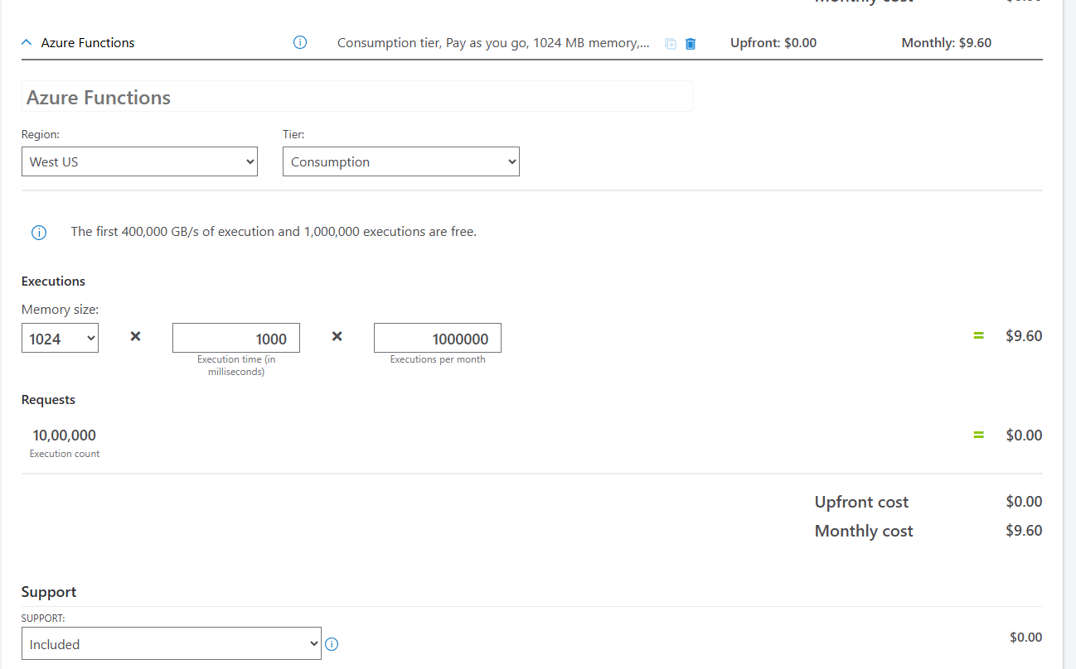
Azure Pricing Calculator

Slide 43
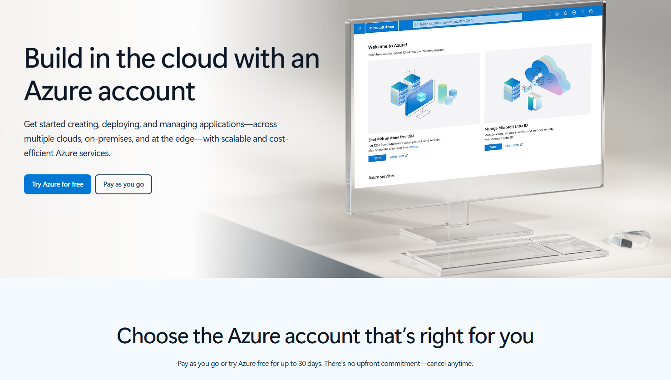
Azure Free Account
https://azure.microsoft.com/en-gb/pricing/purchase-options/azure-account?icid=azurefreeaccount

Slide 44
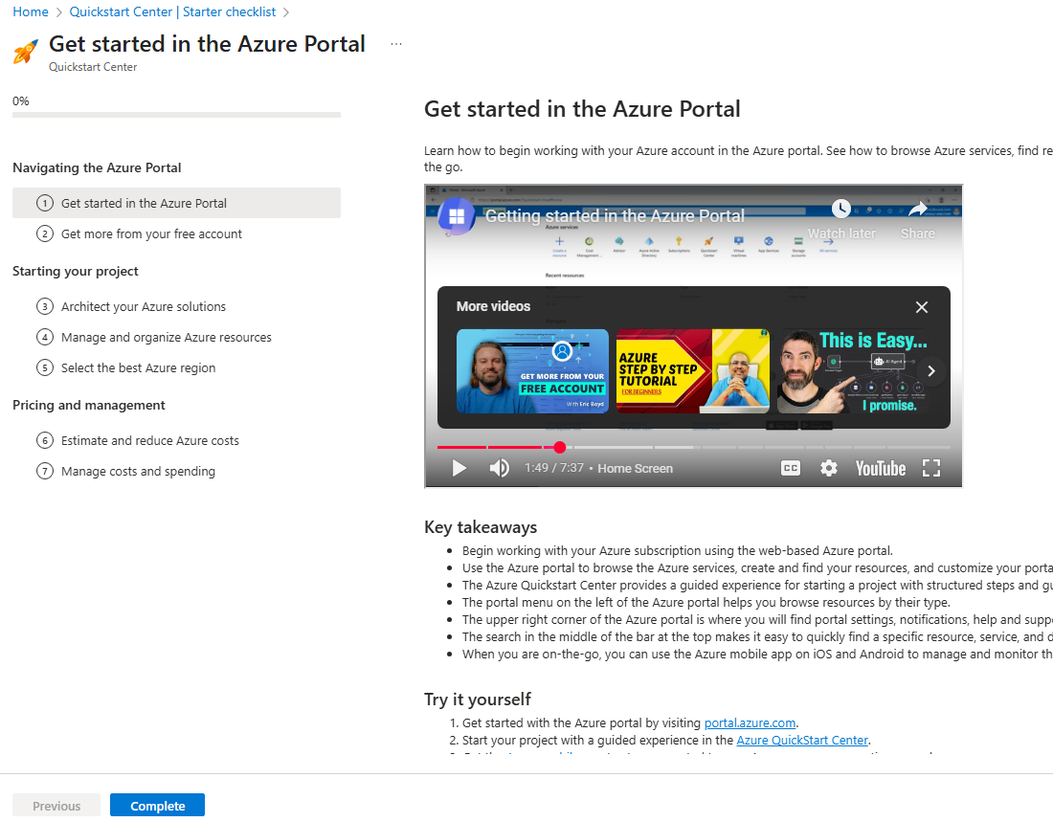
Azure Quick Start
https://portal.azure.com/?quickstart=True#view/Microsoft_Azure_Resources/LessonPage.ReactView/id/get-started-navigating-azure-portal

Slide 45
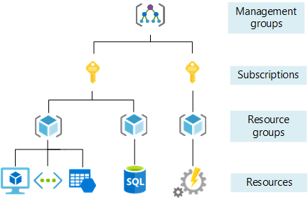
Management levels and hierarchy

Slide 46
Azure Deployment
Azure Portal
Visual Studio
Azure Command Line
GitHub Actions / Azure DevOps Pipelines

Slide 47
Azure Functions Key Types
Key Type | Access Level | Best Use Case
_master (Host) | Full control | Admin scripts, internal automation
default (Function) | One specific function | External clients accessing only one function
default (Host) | All functions | Internal apps needing broad function access

Slide 48
Scaling, Cold Starts & Best Practices
Scaling in Azure Functions
Scaling refers to how Azure Functions automatically adjusts the number of instances running based on incoming workload (requests, events, messages).
Types of Scaling:
Vertical Scaling: Increase the power (CPU, RAM) of a machine. (Not common in serverless)
Horizontal Scaling: Increase the number of instances (more copies of your function).

Slide 49
Scaling Modes by Plan:
Plan Type | Scaling Type | Details
Consumption | Auto-scale (0 to ∞) | Only runs when triggered. Most cost-effective. Scales instantly as load increases.
Premium | Pre-warmed + Auto | Always-ready instances prevent cold starts. Supports VNET, unlimited execution time.
Dedicated (App Service) | Manual or Auto | For high-control environments, shared with web apps.

Slide 50
Scaling Modes by Plan:
Hosting Plan | Max Scale-Out Limit | Notes
Flex Consumption | 1000 instances | High scalability with soft caps. Can handle spikes more elastically.
Consumption | 200 instances (default) | Technically not infinite — this is a soft limit but can be increased via support request.
Premium | 100 instances | Limited but supports warm instances and no cold start.
App Service | 30 instances | Traditional plan with manual scaling.
Container Apps | 300 replicas | KEDA-driven autoscaling, configurable with min/max.

Slide 51
Cold Starts
A cold start happens when Azure needs to spin up a new instance of your function app to handle a request — especially if there are no active instances running.
Why Cold Starts Happen?
App is idle for some time (on Consumption Plan).
No pre-warmed instances.
The platform needs to allocate resources, load dependencies, and initialize the app.

Slide 52
Impact
Impact:
First request takes hundreds of milliseconds to a few seconds.
Critical in low-latency applications like APIs or real-time apps.
How to Reduce Cold Starts:
Use Premium Plan (pre-warmed instances).
Keep function apps "warm" using timers or pings.
Minimize function app start-up time (fewer dependencies, optimize code).

Slide 53
Best Practices
Keep functions lightweight
Write small, single-responsibility functions.
Use durable functions for long-running workflows.
Split unrelated logic into separate function apps.
Optimize dependencies
Avoid heavy dependencies in the startup path.
Load only necessary packages.
Use Dependency Injection (DI) for testability.

Slide 54
Best Practices
Configuration
Set the right timeout values based on your plan.
Use Application Settings for config (don’t hardcode).
💾 Input/Output Bindings
Leverage bindings for blob, queue, event hub, etc. to reduce boilerplate code.
Avoid excessive retries; configure retry policies appropriately.

Slide 55
Best Practices
📊 Monitoring
Enable Application Insights to track performance, failures, logs.
Set up alerts for errors or performance anomalies.
🔐 Security
Use Key Vault to store secrets.
Always use Authorization Levels on HTTP functions.

Slide 56
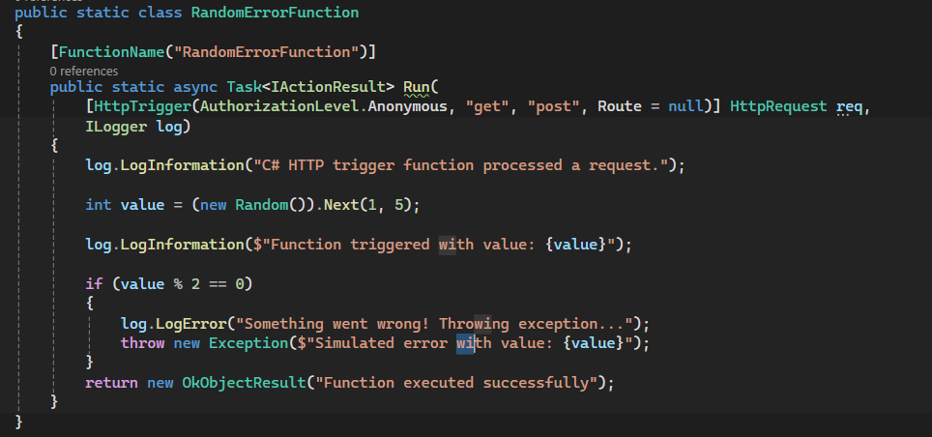
Monitoring using Application Insights

Slide 57
KQL (Kusto Query Langauge)
Exceptions: | Custom Traces: | Failed Requests:
exceptions | order by timestamp desc | traces | where message contains "Function triggered" | order by timestamp desc | requests | where success == false | order by timestamp desc

Slide 58

Durable Functions
Imagine you are organizing a wedding You have to:
Book a hall (takes time),
Send invites (can run in parallel),
Order food (can depend on invites),
Finally confirm everything.
Durable Functions are like your wedding planner — they manage long-running processes by orchestrating tasks with memory of what happened, and resume work even if there are delays or failures.

Slide 59
Durable Functions
Durable Functions are an extension of Azure Functions that let you write stateful workflows in a serverless environment.

Slide 60
Why Use Durable Functions?
Serverless functions are stateless (they forget everything between calls).
Durable Functions keep track of the state using Durable Task Framework.
Useful for:
Long-running processes (e.g., order processing)
Fan-out/fan-in (parallel tasks)
Human interaction (wait for user input)
Scheduled retries

Slide 61
Key Concepts in C#
Component | Purpose
Orchestrator Function | Controls the flow of your logic (like a conductor).
Activity Function | Performs actual work (like sending an email or processing data).
Client Function | Starts the orchestration.

Slide 62
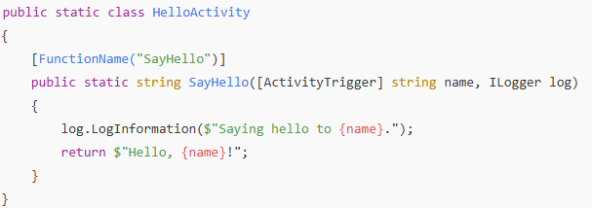
Example in C#
Step 1: Activity Function

Slide 63
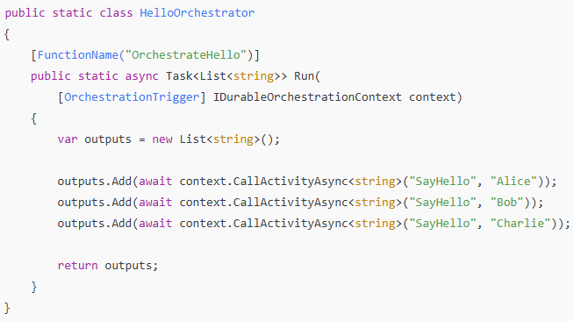
Example in C#
Step 2: Orchestrator Function

Slide 64
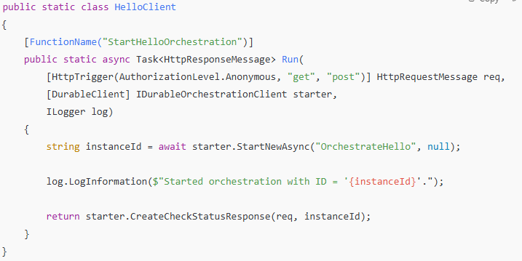
Example in C#
Step 3: Client Function

Slide 65
What Happens Under the Hood
Durable Functions serialize the state of the orchestrator function.
The runtime replays the orchestrator’s progress when restarted.
You write code in a synchronous style, but it executes asynchronously and reliably.

Slide 66

What is Durable Task Framework (DTF)?
Durable Task Framework (DTF) is a .NET library used to write long-running, reliable, and stateful workflows in code.
It helps you write a to-do list (workflow) where the system remembers what steps were completed—even if it shuts down.

Slide 67
Why do we need it?
Without DTF:
If an app crashes mid-process, all progress is lost.
You manually track what’s done and what’s not.
Retry, timeout, and history handling is complex.
With DTF: ✅ Automatic checkpointing ✅ Built-in retries ✅ Can scale across instances ✅ Ideal for orchestrating microservices or long workflows

Slide 68
Execution Flow
Client Function --> Orchestrator --> Activity 1 --> Activity 2 --> Activity 3 --> Done
Client Function starts the workflow
Orchestrator Function schedules activities
Activity Functions do the actual work
Orchestrator handles retries, timeouts, and state checkpoints

Slide 69
Built-In Patterns
Pattern | Use Case
Fan-out/Fan-in | Parallel tasks and aggregation
Human interaction | Waiting for external approval
Sub-orchestrations | Modular workflows
External events | Wait for triggers or signals
Timers and delays | Scheduled activities

Slide 70
Common Use Cases
Order processing (multi-step)
Approval workflows
Data ingestion pipelines
Retry/timeout logic around flaky services

Slide 71
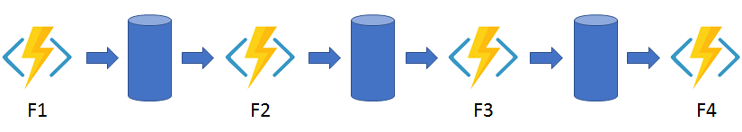
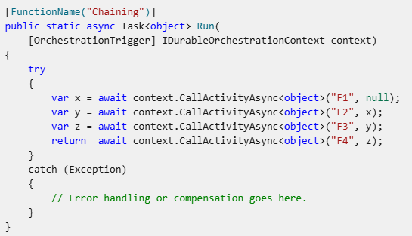
Pattern #1: Function chaining

Slide 72
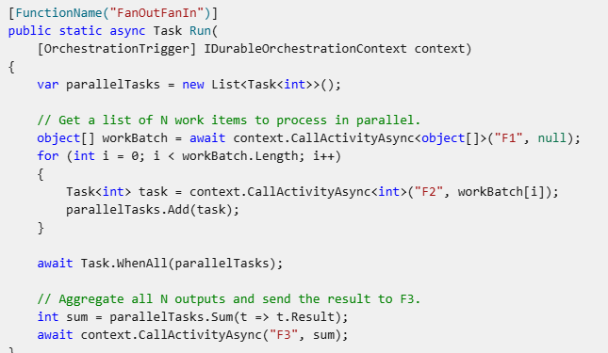
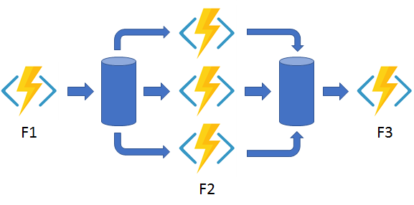
Pattern #2: Fan-out/fan-in

Slide 73
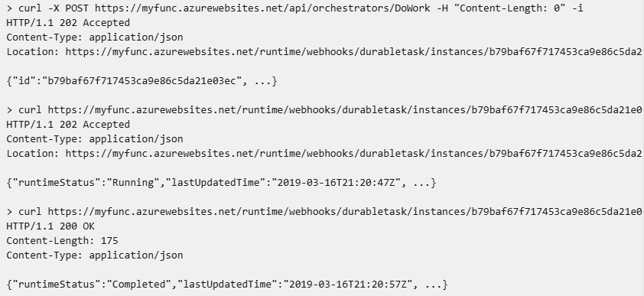
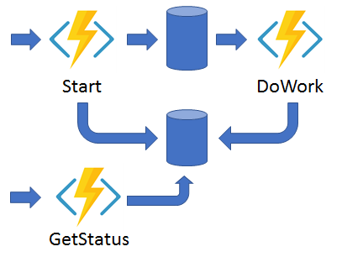
Pattern #3: Async HTTP APIs

Slide 74
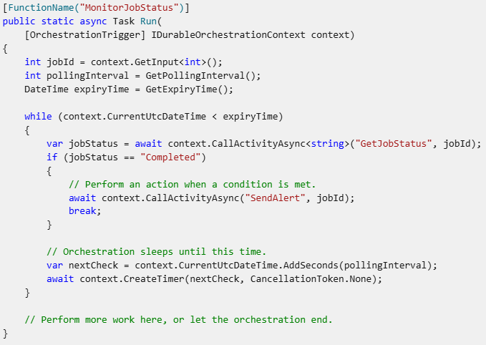
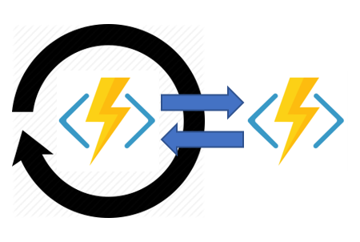
Pattern #4: Monitor

Slide 75
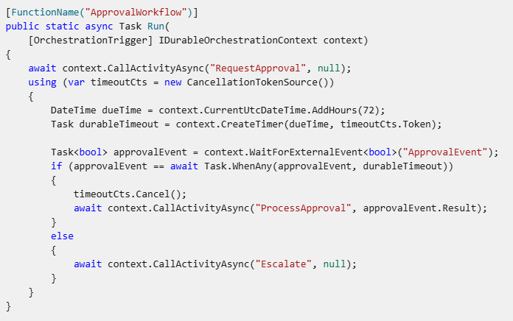
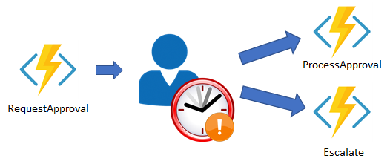
Pattern #5: Human interaction

Slide 76
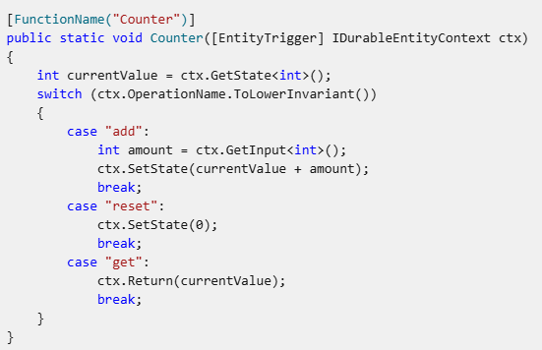

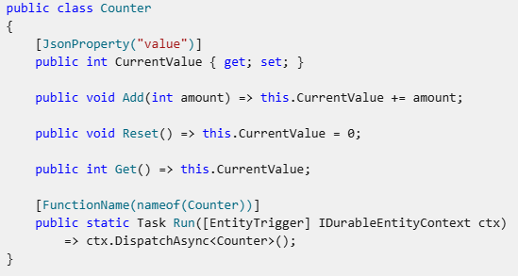
Pattern #6: Aggregator (stateful entities)

Slide 77

Durable Entities
Example: Bank Account System
Think of a bank account. It has a unique ID (like account number), and it stores some state (like balance).
You can perform operations like deposit, withdraw, or check balance.
You don’t want to lose this state even if the system crashes — it must be stored persistently.
You also don’t want two operations (e.g., deposit and withdraw) to interfere with each
other.
This is exactly what Durable Entities solve — they allow you to model such stateful objects
in serverless functions.

Slide 78
What is a Durable Entity?
Durable Entity = a small stateful object hosted in Azure Durable Functions.
It holds state (e.g., balance).
It exposes operations (methods) to update or read the state.
It is addressable by a unique name or ID.
It persists its state reliably across reboots and scaling events.
Multiple clients can concurrently call it safely.

Slide 79
When to Use Durable Entities
You need to manage state over a long time (e.g., carts, games, user sessions, IoT devices).
You want a lightweight, serverless alternative to databases for storing simple state.
You want to avoid shared memory or concurrency bugs in distributed systems.

Slide 80
How They Work Internally
Each entity lives on a logical timeline — every operation is recorded like a message.
Azure ensures that operations are processed one at a time (no race conditions).
Entity state is stored in Azure Storage under the hood.
It's powered by the same infrastructure as Durable Orchestration — event sourcing + storage.

Slide 81
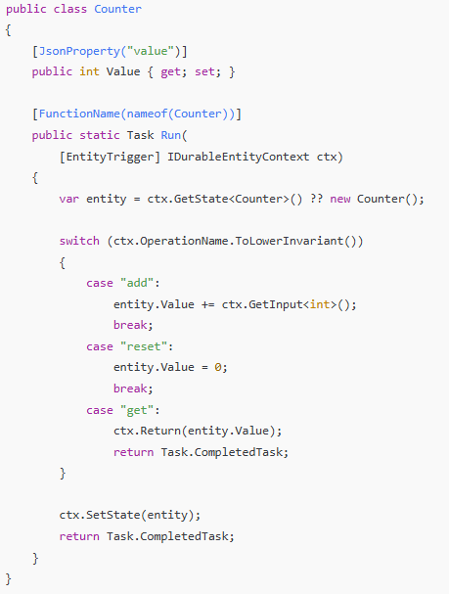
Code Demo (C#)

Slide 82
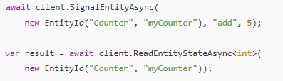
Invoking the Entity

Slide 83
Best Practices to Durable Enties
Keep entities small and focused on a single responsibility.
Avoid large state objects — it’s not a database.
Avoid long-running operations inside entity methods.

Slide 84

Replay & Checkpointing in Durable Functions
Checkpointing
Checkpointing is when the Durable Function saves the current progress/state of an orchestration into storage.
It happens after every await (e.g., after calling an activity function).
Think of it like saving progress in a video game — if your power goes out,
you can resume from the last saved point.

Slide 85
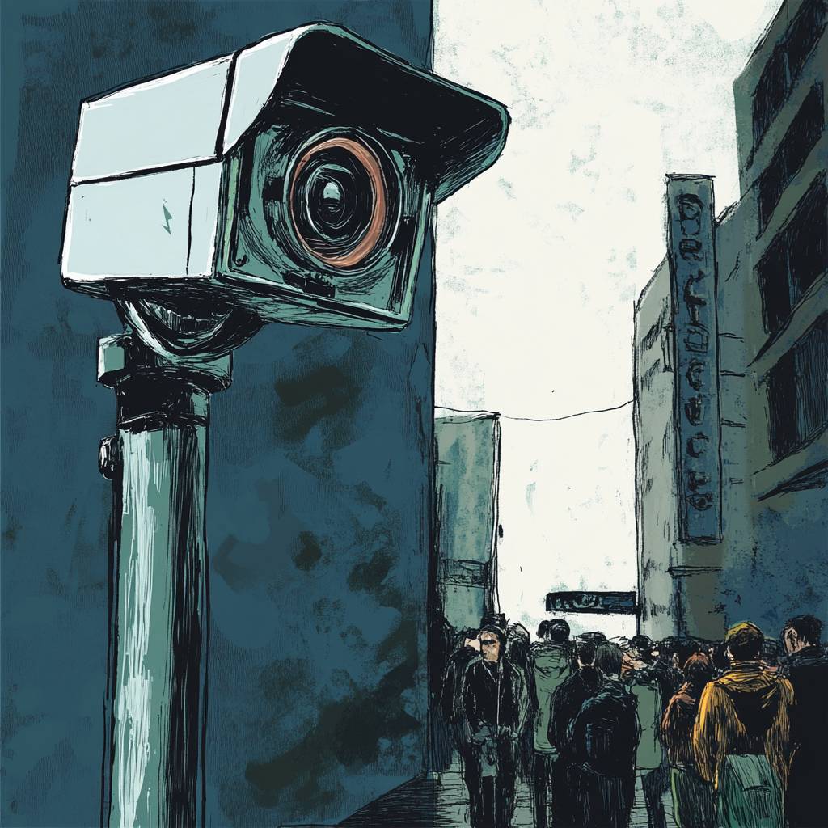
Replay & Checkpointing in Durable Functions
Replay
Replay is when the Durable Function re-runs the orchestrator function from the beginning to rebuild the current state after a restart or resumption.
It’s like watching a recorded CCTV from the start to understand
how something happened — but it always produces the same
outcome step-by-step due to determinism.

Slide 86
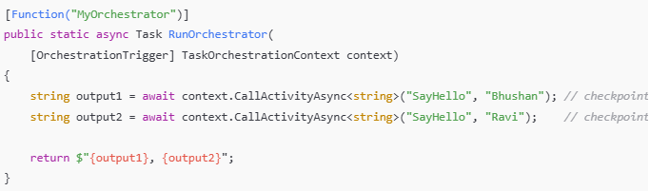
Replay & Checkpointing in Durable Functions
Step | What happens
1️⃣ | HTTP trigger starts orchestration
2️⃣ | SayHello with "Bhushan" is called → checkpoint saved
3️⃣ | Durable function halts execution
4️⃣ | Later, it replays the orchestrator to reach SayHello with "Ravi"
5️⃣ | Calls SayHello with "Ravi" → checkpoint saved
6️⃣ | Final output is returned

Slide 87
Replay & Checkpointing in Durable Functions
Deterministic Code Only
❌ DateTime.Now
❌ new Guid()
❌ Random.Next()
✅ Use context.CurrentUtcDateTime instead of DateTime.Now.

Slide 88
Replay & Checkpointing in Durable Functions
Checkpointing = Auto-save feature
Replay = Replaying steps from the last save to re-establish state
Determinism = Always doing the same thing on replay ensures correctness

